Slide 1
Accelerating Sparse DNN Models without Hardware-Support via Tile-Wise Sparsity
Cong Guo
Shanghai Jiao Tong University

Slide 2
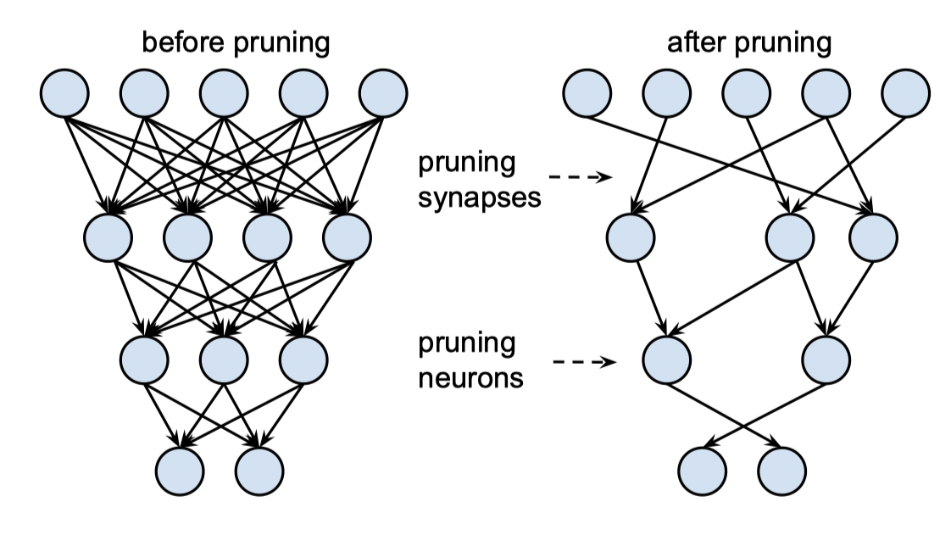
Pruning
Learning both Weights and Connections for Efﬁcient Neural Networks
Song Han NIPS 2015

Slide 3
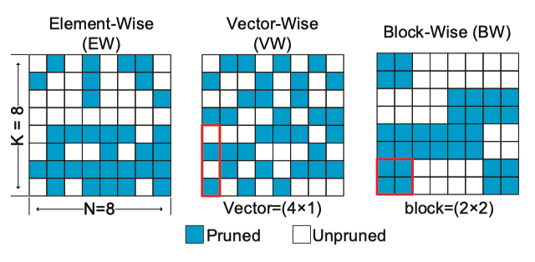
sparsity pattern
Challenge：balance the model accuracy and execution efﬁciency.

Slide 4
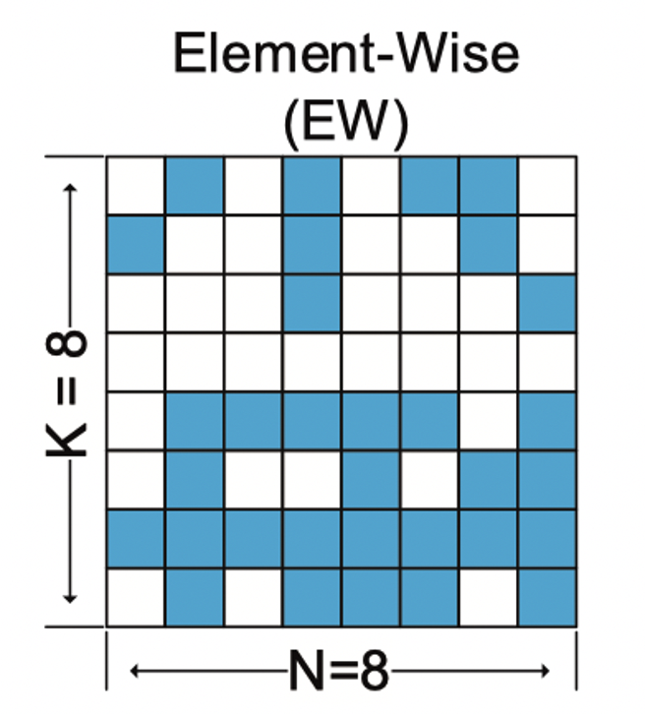
Element-Wise(EW)
Challenge：balance the model accuracy and execution efﬁciency.
最细粒度的剪枝方法
没有约束
最小的模型精度损失
执行效率低
CSR或CSC格式 SpMM

Slide 5
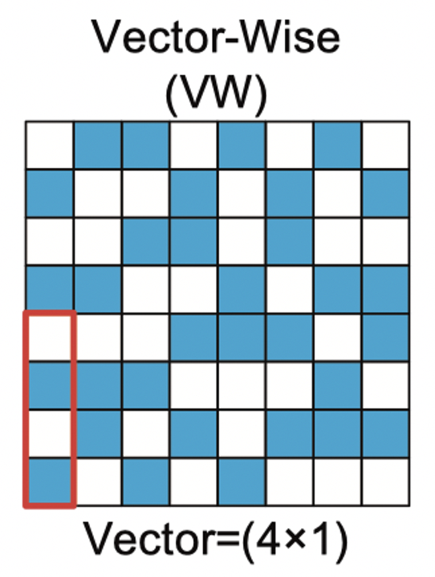
Vector-Wise(VW)
Challenge：balance the model accuracy and execution efﬁciency.
分成多组向量，每个组去掉相同数量的元素。
不能用gemm kernel，不能利用Tenor core
实现需要设计新的硬件结构或者新的算法
（ELL格式的SpMM）

Slide 6
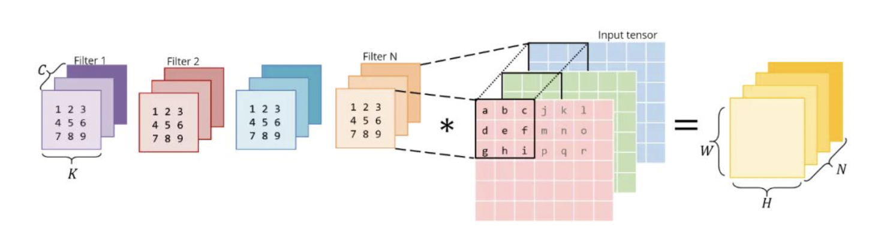
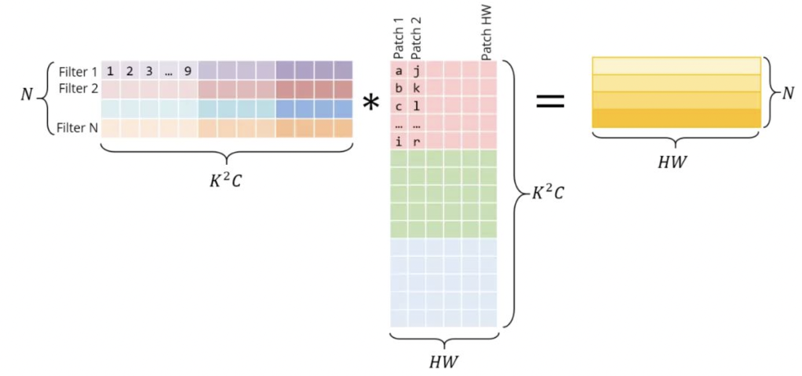
Relation between VW and CNN
im2col

Slide 7
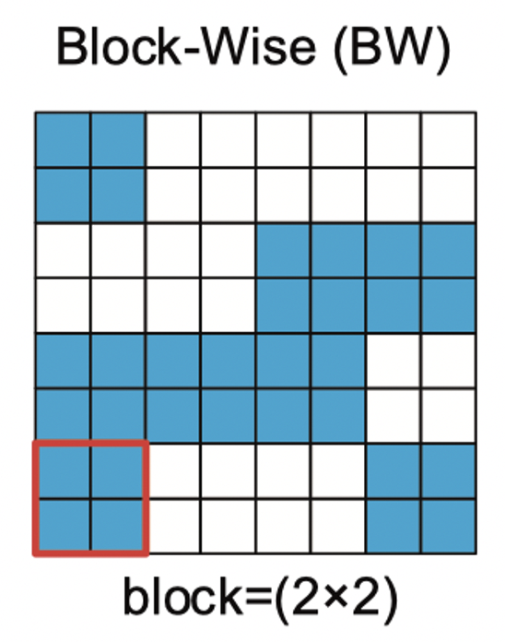
Block-Wise(BW)
Challenge：balance the model accuracy and execution efﬁciency.
分成多组block，以block为剪枝单元
可以用gemm kernel，可以用Tensor core
执行效率高
BSR格式SpMM

Slide 8
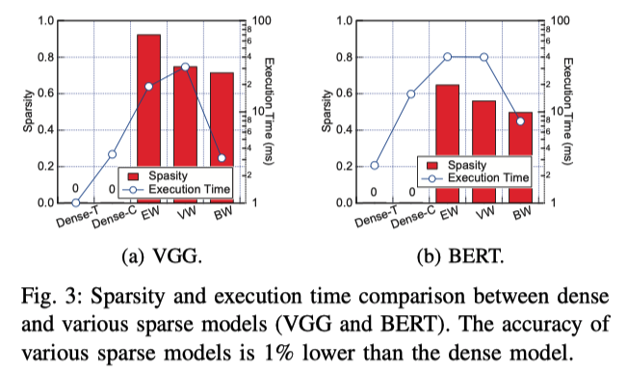
Compare

Slide 9
Target
Challenge：balance the model accuracy and execution efﬁciency.
设计一种新的剪枝模式
模型精度：约束尽可能弱
执行效率：可以利用tensor core高效实现

Slide 10
Contribution

Slide 11
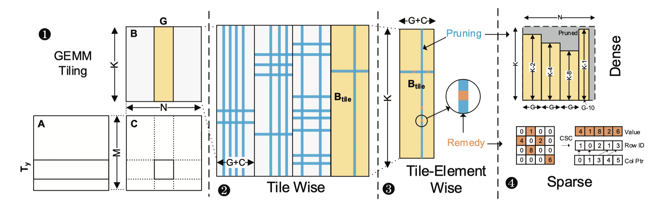
Tiling and Pruning Co-design
Tile-wise (TW) sparsity pattern

Slide 12
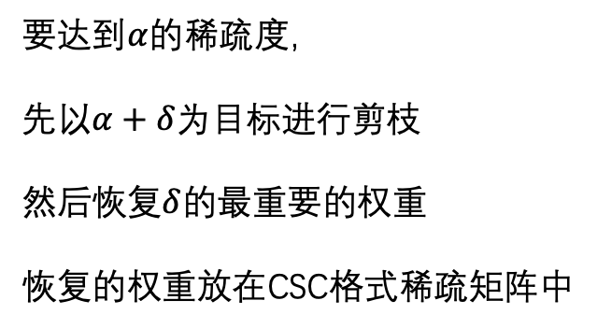
Tile-Element Wise（TEW）
要达到$α$的稀疏度，
先以$α+δ$为目标进行剪枝
然后恢复$δ$的最重要的权重
恢复的权重放在CSC格式稀疏矩阵中

Slide 13
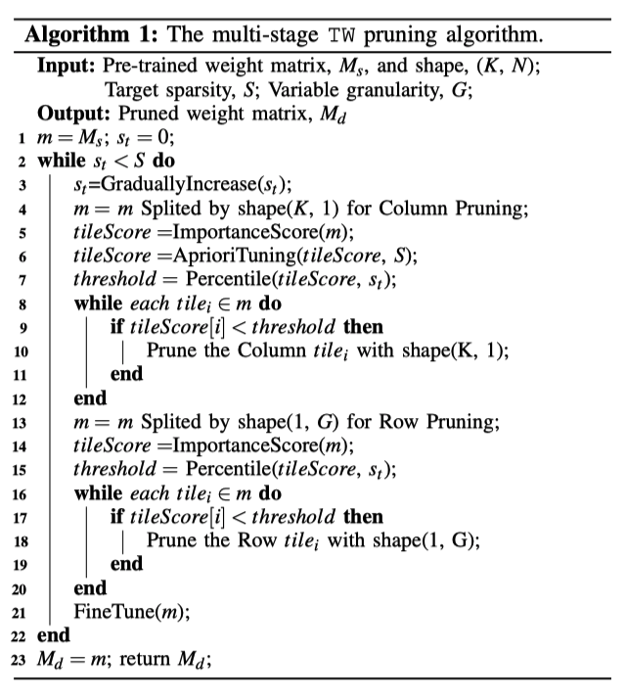
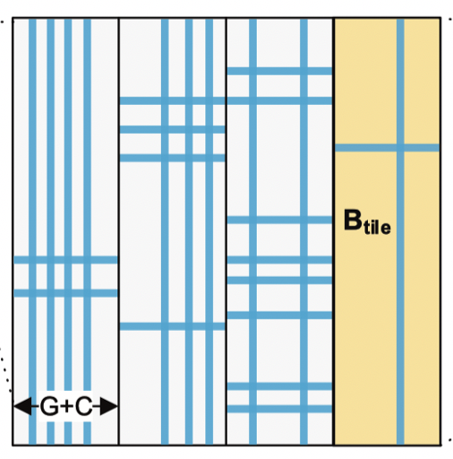
Multi-stage pruning algorithm

Slide 14
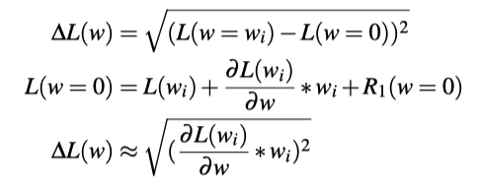
Importance Score
最简单的方法就是看各个weights的绝对值
这篇文章用到一个更精确的方法：
P. Molchanov “Importance estimation for neural network pruning” 2016

Slide 15
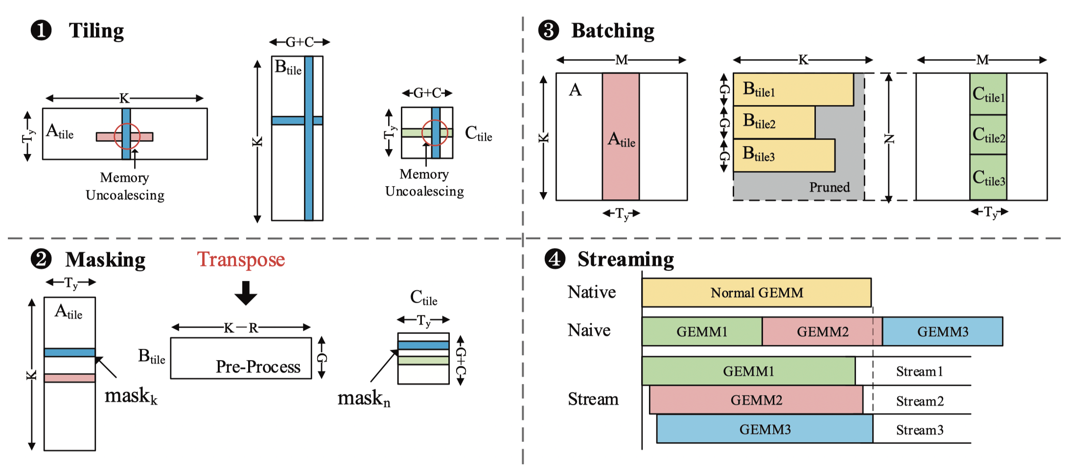
Efficient GPU Implementation

Slide 16
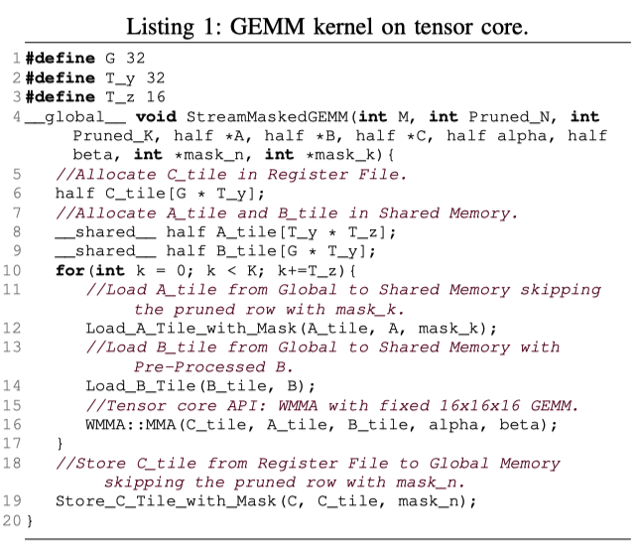
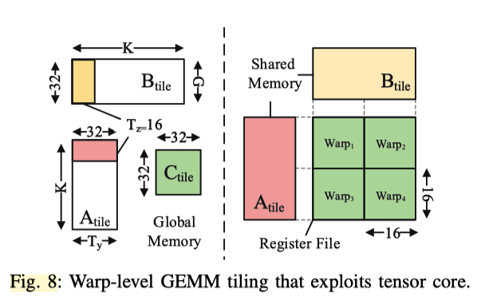
GEMM kernel on tensor core

Slide 17
Evaluation

Slide 18
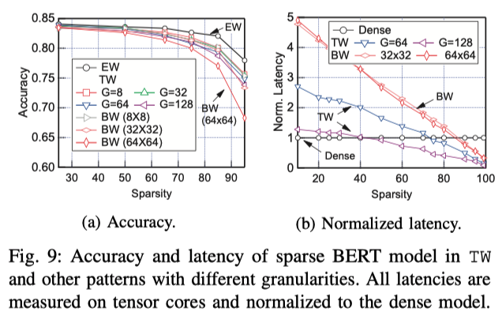
Impact of TW Granularity

Slide 19
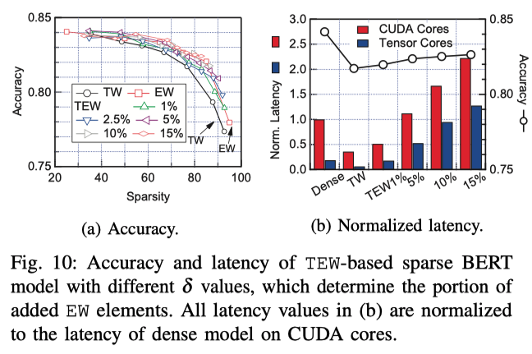
Impact of δ in TEW

Slide 20
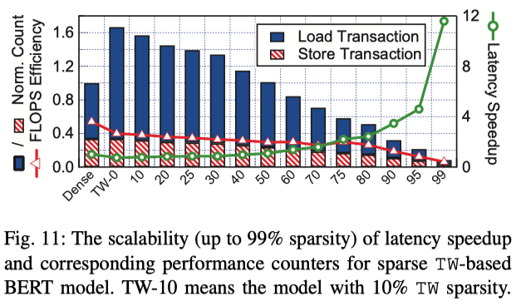
Speedup Scalability Performance Counters.

Slide 21
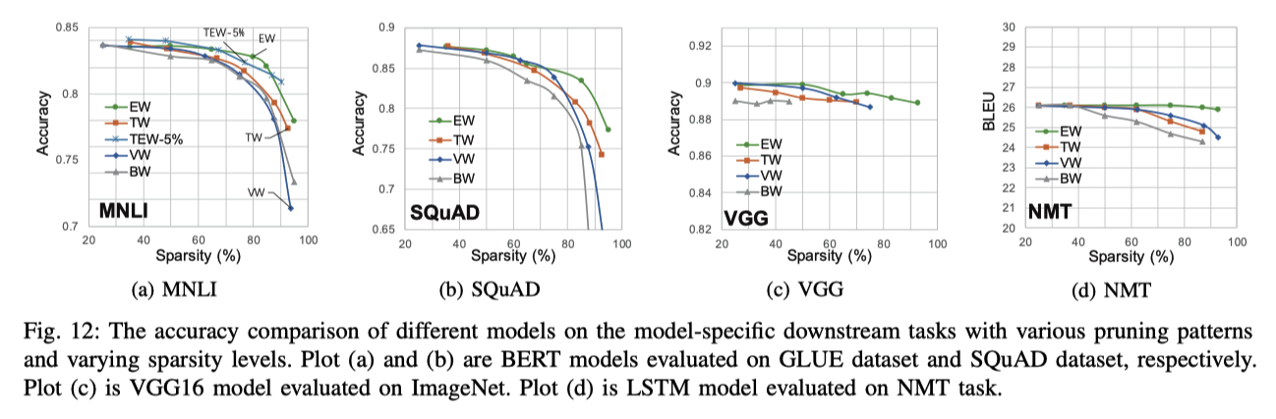
Comparison with Other Patterns-Accuracy

Slide 22
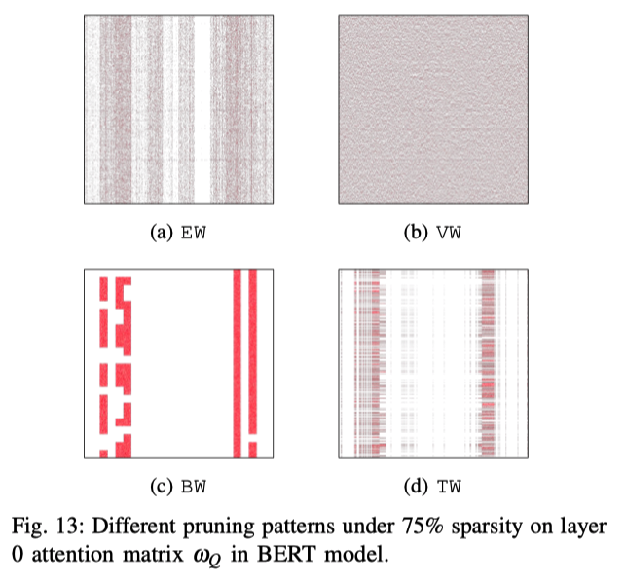
Comparison with Other Patterns-Result

Slide 23
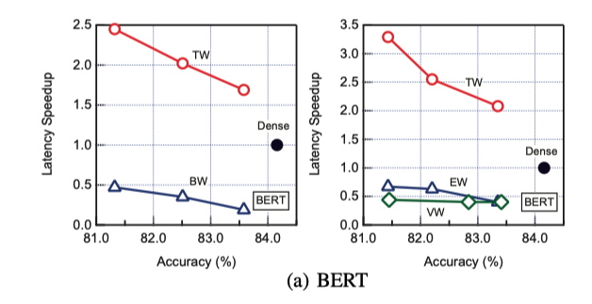
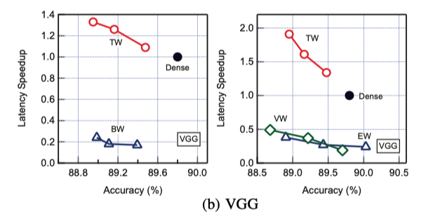
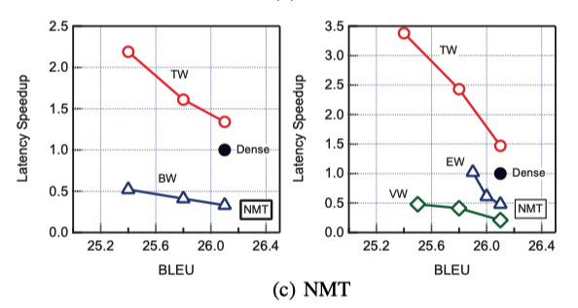
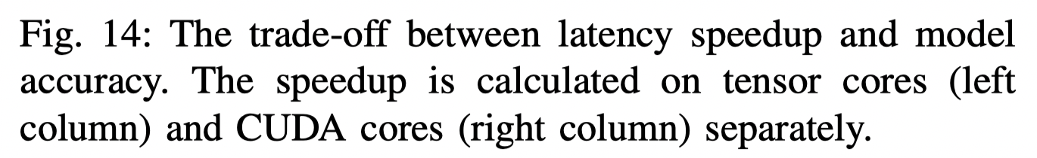
Speedup vs Accuracy

Slide 24
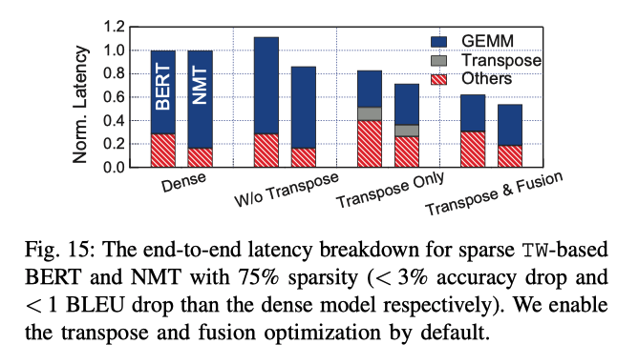
End-to-end Latency and Impact of Optimizations

Slide 25
Conclusion

Slide 26
Conclusion
介绍了几种神经网络的剪枝方法。
剪枝要平衡对模型精度和执行效率的影响
优点：
剪枝方法很新颖，效果也很好
实验很充分，基本上从各个角度都有实验

